Slide 1
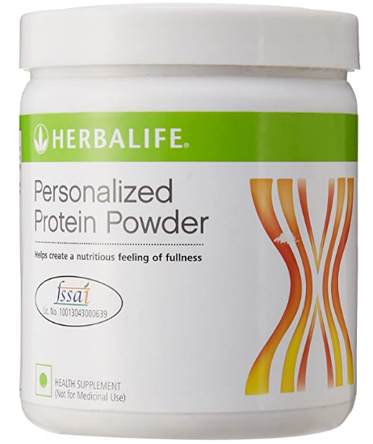
Personalized Protein Powder
SKU # 1233
FSSAI LiC No. 10013043000639
200 gms MRP: Rs. 1,094.00 (inclusive of all taxes)
400 gms MRP: Rs. 2,099.00 (inclusive of all taxes)

Slide 2
PPP Product Overview
Personalized Protein Powder is a highquality, non-fat protein blend that helps build and maintain lean muscle mass
Supports your weight management and fitness goals.
Increased protein intake helps you feel fuller longer and maintain your energy level between meals
Satisfies hunger and provides energy
Personalized Protein Powder (PPP) is a protein supplement which provides 5g of good quality protein (from soy and whey) per serving
It is recommended to consume daily as a protein add on to the diet and for supporting satiety, as part of Herbalife’s weight management program, which includes a healthy and nutritious diet and regular physical activity to support weight loss and maintenance

Slide 3
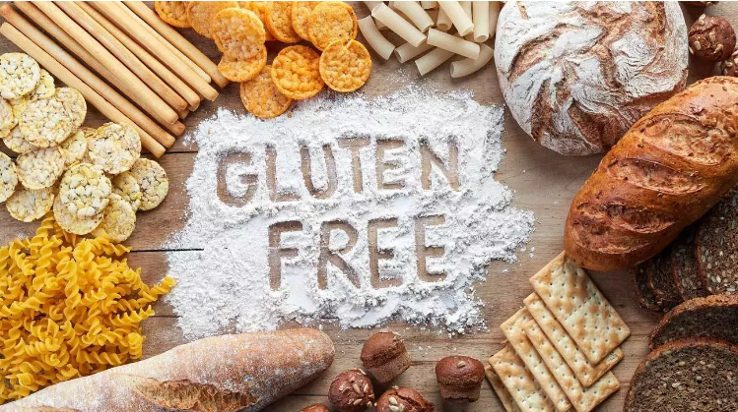
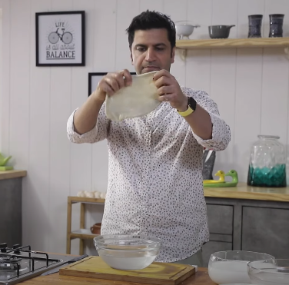
Personalized Protein Powder
Gluten is a family of proteins found in wheat, barley, rye and spelt.
Its name comes from the Latin word for “glue,” as it gives flour a sticky consistency when mixed with water.
Unfortunately, many people feel uncomfortable after eating foods that contain gluten. The most severe reaction is called celiac disease.
Gluten can damage the intestines

Slide 4
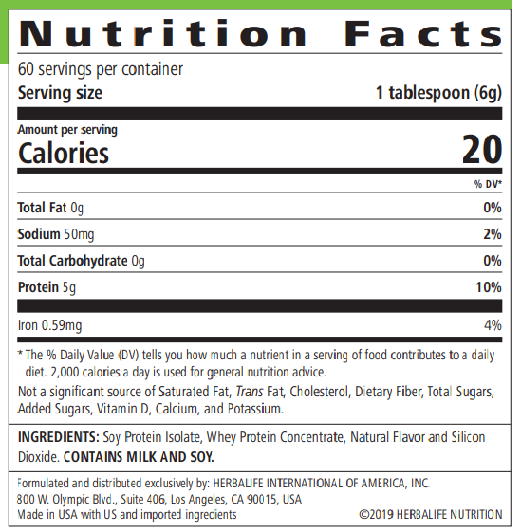

Slide 5
Usage of PPP
Simply mix 1 to 3 scoops of Personalized Protein powder with your favorite beverage, with soup or gravies to get high quality protein from Soy & Whey.
Herbalife Nutrition Recommends:
Women should add up to 2 tablespoons (10g of protein) of Personalized Protein Powder to each Formula 1 shake
Men should add up to 3 tablespoons (15g of protein) to further support weight loss

Slide 6
Thank You
Contact for product purchase
Deepak Solanki (Wellness coach)
M 7698885855

